Slide 1


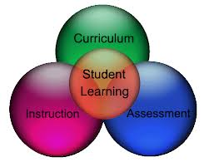
C U R R I C U L U M :
Concept, Models and Development Strategy
Dr. M. Mozahar Ali
Professor, Agril. Extension
GTI-BAU, Mymensingh-2202
Mail: mozahar55@yahoo.co.uk
Cell:88-01711391190
Notes:
Elapsed Time
Content Objective
Related Information
Teaching Method
Constructivist Learning Activity
Examples
Anecdote /Cartoon/Quotation/Joke

Slide 2
Concept of
Curriculum

Slide 3
The Word: Curriculum
Latin: Currere means to run or running track
Scotland 1603: Carriage way, road
United States 1906: Course of study
United States 1940: PLAN for learning (study)
Notes:
Elapsed Time
Content Objective
Related Information
Teaching Method
Constructivist Learning Activity
Examples
Anecdote /Cartoon/Quotation/Joke

Slide 4
What is Curriculum ?
Curriculum is a design PLAN for learning that requires the purposeful and proactive organization, sequencing, and management of the interactions among the teacher, the students, and the content knowledge we want students to acquire.
Notes:
Elapsed Time
Content Objective
Related Information
Teaching Method
Constructivist Learning Activity
Examples
Anecdote /Cartoon/Quotation/Joke

Slide 5
Plan for Something ….NEW
If you always do
what you’ve always done,
you’ll get what you’ve
always gotten.

Slide 6

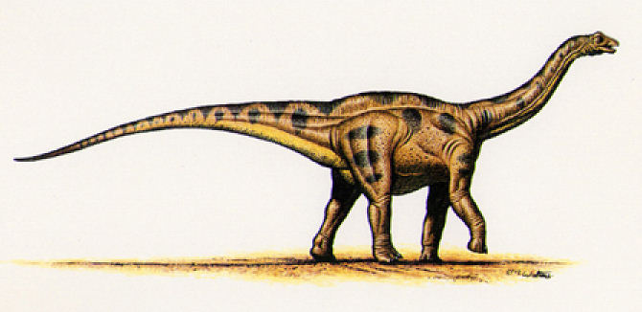
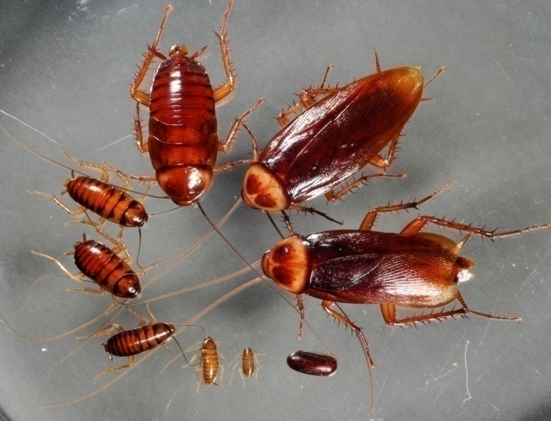


PLAN for Survival
Responsive to Change ..

Slide 7
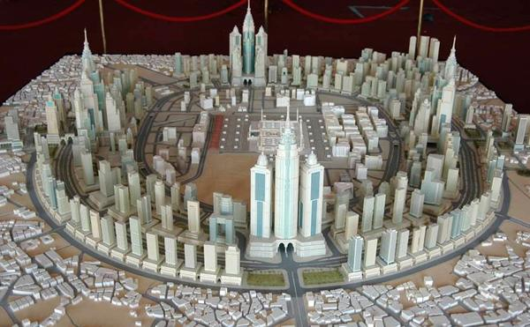
Plan for Modernization
New Plan of Mosque Complex, Medina
Old Plan of Surrounding

Slide 8
What do
I want my students to learn?
Curri-culum
How should
I know whether students learnt?
How should I deliver the contents?

Slide 9
Models
of
Curriculum

Slide 10
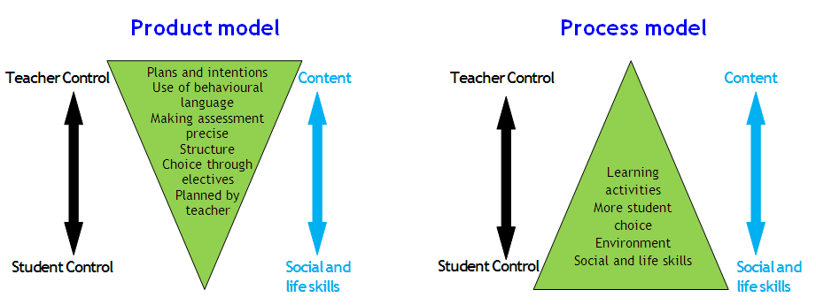
OBL
G. Skills

Slide 11
Specific Models of Curriculum
Ralph W. Tyler Model -1949
Hilda Taba Model - 1962
Nicholls Model - 1978
Lawton Model - 1983
John Kerr Model - 1968
UNESCO Model -
NCTB Model -

Slide 12
Common elements of different Models
Hilda Taba | Kerr & Nicholls | NCTB
Need identification | Situation/ Need analysis | …..
Objective setting | Objectives | Aims & Objectives
Content selection | Content | Content selection
Content organization | ….. | …..
Teaching strategy | Teaching strategy | Teaching materials devt.
Organizing teaching | ….. | Teacher training
Evaluation | Evaluation | Evaluation

Slide 13
Basic Elements of Curriculum
Objective
Methods
Content
Evaluation
(Adapted from Tyler, 1949)

Slide 14
Curriculum Format

Slide 15
NCTB Format (Secondary, 2012)
1. Rationale
2. Objectives
3. Learning outcomes: Cognitive, Affective & Psychomotor
4. Leaning outcomes mapping
5. Course, Chapter & Period distribution/Course Schedule
6. Course-Curriculum Format (Course-wise):
Learning outcome | Content | Teaching Learning Strategy | Assessment Strategy
xxxxxxx xxxxxxx | xxxxxxx | xxxxxxx | xxxxxxx

Slide 16
CURRICULUM FORMAT (Program Level)
1. Vision & Mission
2. Program Objectives
3. Learning Outcomes: Cognitive, Affective & Psychomotor (Product Model)
4. Generic Skills/Graduate Profile (Process Model)
5. Curriculum Structure/Layout (Course Schedule)
6. Learning Experience/Teaching Strategy
7. Assessment Strategy
Part of Ordinance!

Slide 17
DEPARTMENT OF HYDROLOGY, IIT, ROORKEE
M. Tech. (Hydrology)
Curriculum Structure
Sl. No | Course Components | Credit
1. | Advanced Course on Mathematics | 4
2. | Course on Computer Applications | 4
3. | Departmental Core Courses | 24
4 | Courses on Major area of Specialization | 4
5 | Courses on Minor area of Specialization | 8
6 | Project | 4
Total credit requirement for M. Tech |  | 48

Slide 18
Course Schedule/
Curricula lay-out for B.Sc. Fisheries (Hons.) degree: Level-1
.

Slide 19
CURRICULUM FORMAT: Course Profile
Course Level: (Paragraph form)
1. Rationale
2. Objectives
3. Learning Outcomes (ILOs)
4. Course Content (Resource) with References
5. Teaching Strategy/ Learning Experience
6. Assessment Strategy (ILOs)

Slide 20
Rationale/
Description
Linear Curriculum
Design?
Aim
Desired Learning Outcomes
Griffith Graduate Attributes
(Discipline knowledge and skills
+ generic skills)
Content
Context:
Your teaching team (esp. you)
Your Students
Your Teaching Environment
Organisation & Teaching
Strategies
Assessment
Texts &
Supporting Materials
© Duncan D Nulty, Griffith University, AU

Slide 21
Curriculum FORMAT :Course Profile (Matrix Form)
Course Title: …..xxxx Course ID: ….xxxx
Rationale: …..…
Objectives: To familiarize the students with different groups of invertebrates xxx
Learning Outcomes (SLOs) | Course Content | Teaching Strategy/ Learning Experience | Assessment Strategy of SLOs
1. …..… | General survey and classification of animals up to ….. | …..… | …..…
2. …….. | Functional morphology | …..… | …….
3. …….. | Ch-3: …..… | …..… | …..…
……. | …..… | …..… | …..…
Teaching/Learning Resources/References: … (Optional; part of syllabus)

Slide 22
Learning Outcomes
Students will ….
DO WHAT (how)

Slide 23
CURRICULUM FORMAT (Example)
Course Title: …..… Course ID: …..…
Rationale: …..…
Objectives : …..…
Learning outcomes (ILOs) | Course content/ Learning experience | Teaching strategy | Assessment strategy of ILOs
(a) Identify quality issues & related methods and (b) develop tools for QA: (CAP) | Quality assurance issues in higher education | Lecture, discussion & group exercise | Q/A, test, assignment
(a) Aware about ethics, roles and duties of faculties: (CA) | Professional roles, duties and qualities of university teachers | Lecture & group discussion | Q/A, test

Slide 24
CURRICULUM FORMAT (Example contd..)
Objectives/ Learning outcomes (SLOs) | Course content | Teaching strategy/ Learning experience | Assessment strategy of SLOs
(a) Determine assessment goals, (b) identify strategies, (c) prepare tools and (d) assign score correctly(CP) | Assessment of learning: Goals, tools and strategies | Lecture, exercise | Quiz, test, assignment
(a) Define curriculum, (b) explain models & procedures of CD; (c) prepare & (d) evaluate curriculum. (CAP) | Curriculum: concept, models and format; procedures of curriculum development & evaluation | Lecture, exercise | Quiz, test, assignment

Slide 25
Curriculum
Process
Planning
Development
Implementation

Slide 26
Planning
Formation of Curriculum Development Team
Subject Matter Specialists (internal and External)
Curriculum Specialists
Dean, Head of the Department
Student representatives/Alumni
Employer Representatives
UGC Representative
Prominent Scholars
Registered Graduate/Senate Members
Parents/Community Representatives
Needs Assessment/Situation Analysis

Slide 27
Development
Determine Aims (Vision & Mission)
General Objectives
Formulate the objectives in behavioral terms (Cognitive, Affective, Psychomotor domain)
Developing learning outcomes (Cognitive, Affective, Psychomotor domain)
Content selection (considering the relevant principles and Maxims)
Content Organization (considering relevant principles and Maxims)
Guidelines for the Instructional Materials Developers/ writers

Slide 28
Development (contd.)
Selection of Instructional Strategies
Teaching Aids/Planned Activities (Learning experiences)
Selection of Student Assessment Techniques
Draft Curriculum Evaluation: Piloting/Rationale Evaluation/ Seminar/ Online/others
Modification of the Draft Curriculum
Final Curriculum

Slide 29
Implementation
Teachers’ Training
Administrative supports
Infrastructural facilities
Educational Facilities
Lab Facilities
Internship
Monitoring and Formative Assessment
(For Renew and Modification)

Slide 30
Curriculum
Evaluation

Slide 31
Curriculum Review for QA & Accreditation
Effectiveness of Curriculum in achieving the Learning Outcomes
Programs are at a Suitable Academic Level
Curriculum facilitates Progress to Employment and/ or Further Study
How often the Curriculum is Reviewed by the Dept.?
How Student Feedback, Comments from Examiners and Employer Views are taken into account in Reviewing Curriculum?

Slide 32
Curriculum Standards
Standard 1-1: The curriculum must be consistent and support the program’s documented objectives (Alignment).
Meeting Standard 1-1
Describe how the program content (courses) meets the program objectives
Complete the matrix shown in Table 1.1 linking courses to program outcomes. List the courses and tick against relevant outcomes.

Slide 33
Meeting Standard 1-1: (Alignment)
Courses or Groups of Courses | Program Objectives
 | 1 | 2 | 3 | 4 | 5 | 6 | 7
1.
2.
3.
4.
5.
6.
7.
8.
9.
Courses Vs. Program Outcomes

Slide 34
Curriculum Standards
Standard 1-2: Theoretical background, problems analysis and solution design must be stressed within the program’s core material.

Slide 35
Meeting Standard 1-2
Indicate which courses contain a significant portion (more than 30%) of the elements in standard 1-2 in the following table.
Elements | Courses
Theoretical Background
Problem Analysis
Solution Design

Slide 36
Meeting Standard 1-2 (example)
Elements | Courses
Theoretical Background | All Courses with the exception of ENGL, IS and PS
Problem Analysis | All courses with the exception of ENGL, IS, PS and COE 390.
Solution Design | COE 200, 205, 305, 360, 400, 485, ICS 202, 399
Standard 1-2 Requirement

Slide 37
Standard 1-3: The curriculum must satisfy the mathematics and basic sciences requirements for the program, as specified by the respective accreditation body.
Standard 1-4: The curriculum must satisfy the major requirements for the program as specified by the respective accreditation body.

Slide 38
Table-1.5: Minimum Requirements for Each Program
(Program Semester Credit Hours)
Standard 1-5: The curriculum must satisfy humanities, social sciences, arts, ethical, professional and other discipline requirements for the program, as specified by the respective accreditation body.
Programs | Maths & Basic Sciences | Engineering Topics | General Education |  | Others
BE Mechanical Engg | 20 | 67 | 10 |  | 03
MBBS | 94 | 1 | 05

Slide 39
Standard 1-6: Information technology component of the curriculum must be integrated throughout the program
1-6: IT contents of the program
Courses | IT Contents
CS-201: Software Applications | Office: Word Excel MS Word, Excel, PowerPoint, Computer basics, Use of internet
CS-202: Programming | C++, Virtual Basic

Slide 40
1-7: List of courses which develop oral and written communication skill
Standard 1-7: Oral and written communication skills of the student must be developed and applied in the program.
Course Code | Title
Eng-102 | Communication Skill
Mech-204 | Technical Report and Thesis writing

Slide 41
Course Syllabus
Essential Information
Course title, number, time, days, and location; URL for course Web page, if applicable
Name and contact information of instructor(s) and, if applicable, TA(s)
Prerequisites
Topics outline: (a) abridged content
(b) Lecture schedule/Content outline
5. Texts, materials, and supplies

Slide 42
Course Syllabus
Essential Information
6. Assignments and exams
7. Additional course requirements, such as field trips,
seminars, or group work
8. Grading scale and policies
9. Additional policies, such as those on attendance,
academic integrity, and late work
(See detail in my note on Preparing a Syllabus)

Slide 43
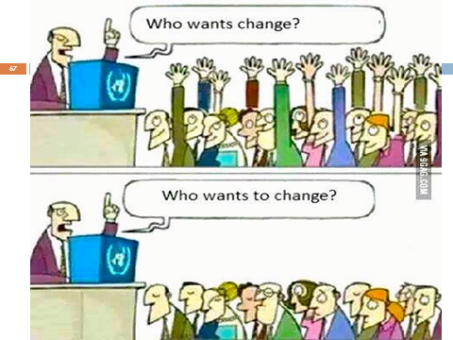

Slide 44


Slide 45

THANK YOU ALL
Have a nice day!
Notes:
45
45

