Slide 1
Graduate Profile Generic Skills, Graduate Skills, Employability Skills/… … 21st-Century Skills (AQFC)
Dr. M. Mozahar Ali
Professor, Agril. Extension
GTI, BAU, Mymensingh
Mail: mozahar55@yahoo.co.uk
Cell:88-01711391190

Slide 3
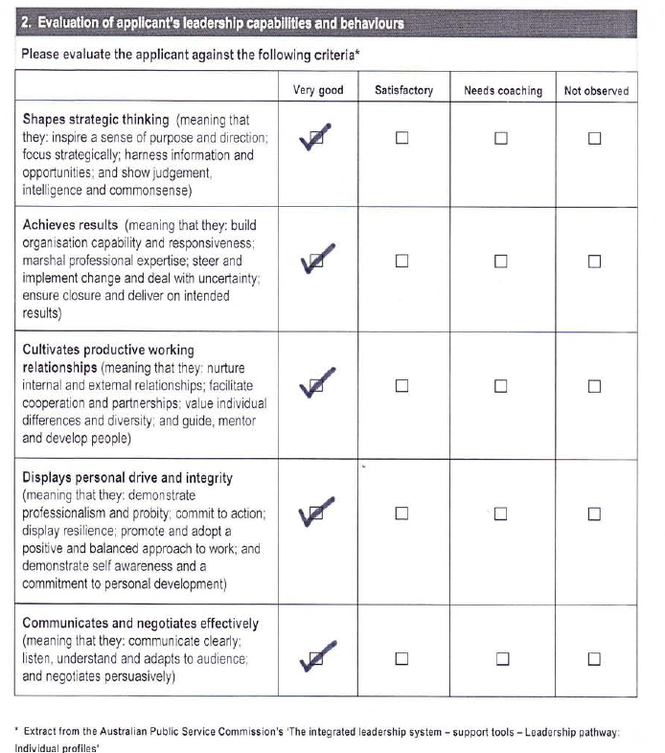

Slide 4
TO WHOM IT MAY CONCERN
Mr...... is personally known to me since 1992, .........
I found Mr. … as a smart, regular and studious student having full devotion to his studies. He also possesses good moral character. Academically he is very sound and has a solid foundation. .......
Mr. .... is known for his honesty and integrity. He has the ability to think critically and strategically about the scholarly enquiry. So far as I observed he is adept at communicating with others. ..... He gets on well with people around him. might play a leading role to bring about a qualitative change in the teaching and research of the university where he has been working. Additionally he might contribute to the development of the country by being involved in different nation building activities.

Slide 5
Graduate Profile/Generic Skills
The Graduate Profile is a description of the personal qualities, skills and attributes a student is expected to obtain by the end of an undergraduate degree program at the University.
Graduate Profiles are skills that equip graduates for employment and citizenship and lay the foundations for a lifetime of continuous learning and personal development.

Slide 6
Graduate Profile/Generic Skills
The ‘Graduate Profile' is:
An ideal toward which we direct the student.
A tool to assess the extent to which we are accomplishing our VISION.
Graduate Profile is also Known as:
Generic skills, general capabilities, graduate skills, graduate attributes, soft skills, key skills, common skills, core skills, basic skills, essential skills, employability skills, transferable skills, necessary skills, 21st century skills, key competence, etc.

Slide 7
Graduate Profile/Generic Skills
Graduate profile is not yet fixed/formulated by the HE authority of Bangladesh.

Slide 8
Graduate Profile/Generic Skills
Sought by:
Employer
Promotion Committee
Sponsoring Authority
PG Admission Committee
PG Research Supervisor
Curriculum Committee: Develop/Review
Teacher: for involving students in learning it & for evaluating
Students: Self Development
QAA committees

Slide 9
GRADUATE PROFILE (Sri Lanka)
Minimum Performance Level for Graduates: Generic Skills
Intellectual Skills
Practical Skills
Numeracy Skills
Communication Skills (English)
IT Skills
Interpersonal and Teamwork Skills
Self Management and Professional Development Skills
Importance
1 | 2 | 3 | 4 | 5

Slide 10
Graduate Profile: NCCA, Ireland, 2003
Entrepreneurship and innovation
Research skills and awareness
Communication skills
Team-working and leadership
Personal effectiveness/development
Career management

Slide 11
Graduate Profile: New Zealand, 1993
Work and study
Problem-solving
Numeracy
Communication
Information
Social and cooperative
Self-management
Physical

Slide 12
Graduate Profile: Australia (ATCS, 2009) (Considered EU, OECD, UK, USA, Japan, ..)
Critical thinking, problem-solving, decision-making
Creativity and innovation
Personal and social responsibility – including cultural awareness
Communication
Information literacy (includes research on sources, evidence, biases etc.), ICT literacy
Collaboration (teamwork)
Learning to learn, meta-cognition
Life and career
Self management and development skill
Citizenship – local and global
Ref: Bowman, K. 2010. Background paper for the AQF Council on generic skills.

Slide 13
Graduate Profile: Australia NCVER
1. Basic fundamental skills | e.g. literacy etc
2. People-related skills | e.g. teamwork etc
3. Conceptual thinking skills | e.g. problem-solving etc
4. Personal skills and attributes | e.g. responsible, ethical etc
5. Skills related to the business world | e.g. enterprising etc
6. Skills related to the community | e.g. citizenship knowledge, respect for diversity

Slide 14
Graduate Profile: Malaysia MQA (Adopted UK, USA, NZ & Australia)
Knowledge of the discipline-Content (1)
Practical skills (2)
Problem solving & scientific skills (6)
Communication skills, leadership and team skills (5)
Information management and lifelong learning skills (7)
Social skills, teamwork and responsibilities (3)
Values, attitudes and professionalism (4)
Managerial and entrepreneurial skills (8)

Slide 15
GRADUATE PROFILE (University of Auckland)
Importance
1 | 2 | 3 | 4 | 5
A. Specialist knowledge
A mastery of a body of knowledge, including an understanding of broad conceptual and theoretical elements, in the major fields of study.
An understanding and appreciation of current issues and debates in the major fields of knowledge studied.
An understanding and appreciation of the philosophical bases, methodologies and characteristics of scholarship, research and creative work.

Slide 16
GRADUATE PROFILE (University of Auckland)
B. General intellectual skills and capacities
A capacity for critical, conceptual and reflective thinking.
An intellectual openness and curiosity.
A capacity for creativity and originality.
Intellectual integrity, respect for truth and for the ethics of research and scholarly activity.
An ability to recognize when information is needed and a capacity to locate, evaluate and use this information effectively.
Importance
1 | 2 | 3 | 4 | 5

Slide 17
GRADUATE PROFILE (University of Auckland)
B. General intellectual skills and capacities
6. An awareness of international and global dimensions of intellectual, political and economic activities, and distinctive qualities of Āotearoa/New Zealand.
7. An ability to access, identify, organize and communicate knowledge effectively in both written and spoken English and/or Māori.
8. An ability to undertake numerical calculations and understand quantitative information.
9. An ability to make appropriate use of advanced information and communication technologies.
Importance
1 | 2 | 3 | 4 | 5

Slide 18
GRADUATE PROFILE (University of Auckland)
Importance
1 | 2 | 3 | 4 | 5
C. Personal qualities
A love and enjoyment of ideas, discovery and learning.
An ability to work independently and in collaboration with others.
Self-discipline and an ability to plan and achieve personal and professional goals.
An ability to lead in the community, and a willingness to engage in constructive public discourse and to accept social and civic responsibilities.
Respect for the values of other individuals and groups, and an appreciation of human and cultural diversity.
Personal and professional integrity and an awareness of the requirements of ethical behaviour.
Approved by Senate: 3 March 2003

Slide 19
Griffith University aims to prepare its graduates to be leaders in their fields by being:-
Knowledgeable and Skilled in their Disciplines
Effective Communicators and Team Members
Innovative and Creative, with Critical Judgment
Socially Responsible and Engaged in their Communities
Competent in Culturally Diverse and International Environments

Slide 20
Graduate Profile: Sept.’12 Workshop, HELP
Exhibit knowledge and skills in the field of study
Apply knowledge and understanding for professional purpose
Utilize creative and innovative skills in identifying, analyzing and solving problems
Communicate effectively and demonstrate the use of information technology in the advancement of the profession
Support the development of knowledge through research activities
Apply teamwork and leadership skills for efficient performance
Pursue personal and professional development in the spirit of lifelong learning
Contribute to and act responsibly within the community
Develop and demonstrate values and attitudes relevant to a professional in the field
Demonstrate relevant techniques and abilities to address and solve social and ethical issues

Slide 21
Graduate Profile: BAETE (Board of Accreditation for Engineering & Technical Education)
Academic Education
Knowledge of Engineering Sciences
Problem Analysis
Design/Development of Solution
Investigation
Modern Tool Usage
Individual & Team Work
Communication
The engineer and Society
Ethics
Environment & Sustainability
Project Management & Finance
Lifelong Learning

Slide 22
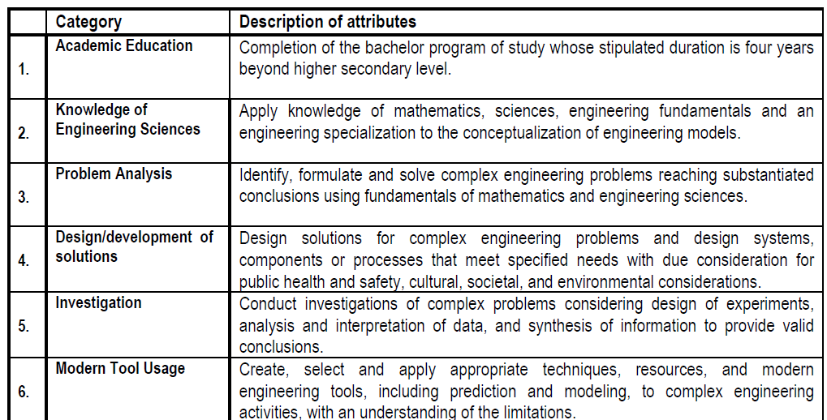
BAETE Graduate Attributes Profile
Contd.

Slide 23
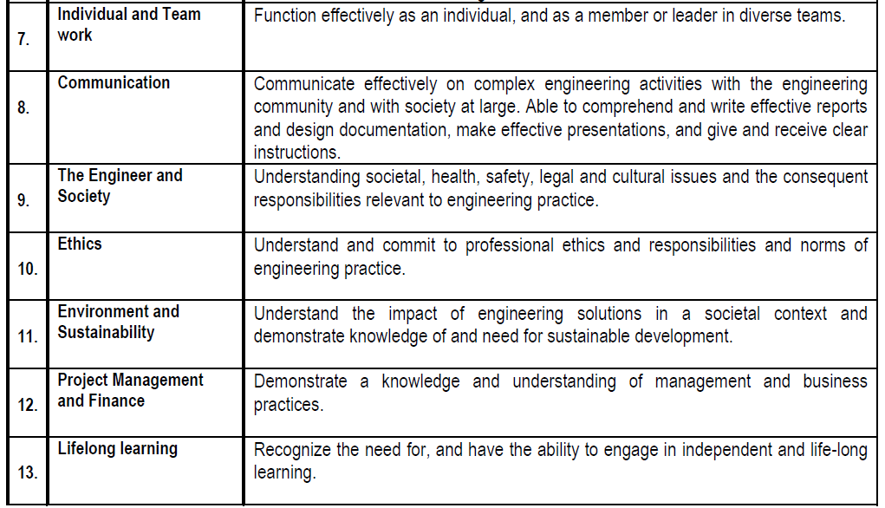
BAETE Graduate Attributes Profile

Slide 24
Graduate Profile: Education Commission, 1974 & ’88
Goals & Objectives of Higher Education (Islam, 2012:26-27):
Is knowledgeable & farsighted
Have practical and problem solving skills
Have innovative & entrepreneurial skills
Have information acquisition and analytical skills
Possesses vision and leadership skills
Have love for solving social & national problems
Possesses honesty, sense of justice, freedom of thought
Possesses skills for life-long learning & professional development

Slide 25
Sri Lanka (7:31) (Adopted UK & USA) | New Zealand, 1993 | NCCA, Ireland, 2003 | Australia, ATCS Project (10) | Malaysia (Adopted UK, NZ, USA & Australia) | Colin’s Workshop, UGC (9) | QAA Workshop, HELP, Malaysia (10)
Intellectual skill (1:7) | Work and study | Entrepreneurship and innovation | Critical thinking, problem-solving, decision-making | Knowledge of the discipline-Content (1) | Intellectual skill | Exhibit knowledge and skills in the field of study
Practical Skill (2:6) | Problem-solving | Research skills and awareness | Creativity and innovation | Practical skills (2) | Practical Skill | Apply knowledge and understanding for professional purpose
Numeracy skill (3:3) | Numeracy |  | Personal and social responsibility – including cultural awareness | Problem solving & scientific skills (6) | Numeracy skill | Utilize creative and innovative skills in identifying, analyzing and solving problems
Communication skill (4:3) | Communication | Communication skills | Communication | Communication skills, leadership and team skills (5) | Communication skill | Communicate effectively and demonstrate the use of information technology in the advancement of the profession
ICT skill (5:3) | Information |  | Information literacy (includes research on sources, evidence, biases etc.) ICT literacy | Information management and lifelong learning skills (7) | ICT Skill | Support the development of knowledge through research activities
Interpersonal and teamwork skill (6:3) | Social and cooperative | Team-working and leadership | Collaboration (teamwork) | Social skills, teamwork and responsibilities (3) | Interpersonal skill | Apply teamwork and leadership skills for efficient performance
Self management and professional development skill (7:6) | Self-management | Personal effectiveness/ development | Learning to learn, meta-cognition | Values, attitudes and professionalism (4) | Team work skill | Pursue personal and professional development in the spirit of lifelong learning.
 | Physical | Career management | Life and career | Managerial and entrepreneurial skills (8) | Leadership skill | Contribute to and act responsibly within the community
 |  |  | Self management and development skill |  | Analytical Skill | Develop and demonstrate values and attitudes relevant to a professional in the field
 |  |  | Citizenship – local and global |  |  | Demonstrate relevant techniques and abilities to address and solve social and ethical issues;

Slide 26
Graduate Profile | Sri Lanka | NZ, 1993 | NCCA, Ireland, 2003 | AUS, ATCS Project | MY (UK, NZ, US & AU) | Colin’s WS, UGC (9) | QAA WS, HELP, (10)
Number → | 7 | 8 | 6 | 10 | 8 | 9 | 10
1. Intellectual skill | x |  |  | x | x | x | x
2. Problem solving |  | x |  |  | x |  | x
3. Entrepreneurship and innovation |  |  | x | x | x
4. Research skills and awareness |  |  | x |  | x | X? | x
5. Work and study |  | x
6. Practical Skill | x |  |  |  | x | x | x
7. Numeracy skill | x | x |  |  |  | x
8. Communication skill | x | x | x | x | x | x | x
9. ICT skill | x |  |  | x |  | x | x
10. Information |  | x |  | x | x |  | x
11. Interpersonal and teamwork skill | x |  |  | x | x | x | x
12. Teamwork and leadership |  |  | x |  | x | x | x
13. Social & cooperative |  | x |  |  | x |  | x
14. Self management and professional development skill | x | x |  | x | x |  | x
15. Personal effectiveness/development |  |  | x |  |  |  | x
16. Physical |  | x
17. Career management |  |  | x | x
18. Personal and social responsibility – including cultural awareness |  |  |  | x |  |  | x
19. Learning to learn, meta-cognition |  |  |  | x | x

Slide 27
Graduate Profile (UGC, Oct. 2012) | Sri Lanka | NZ, 1993 | NCCA, Ireland, 2003 | AUS, ATCS Project | MY (UK, NZ, US & AU) | Colin’s WS, UGC (9) | QAA WS, HELP, (10)
Number → | 7 | 8 | 6 | 10 | 8 | 9 | 10
1. Cognitive skill | x |  |  | x | x | x | X
2. Practical & problem solving skill | x | x |  |  | xx | x | xx
3. Numeracy & analytical skill | x | x | x |  | x | x | x
4. Entrepreneurship and innovation |  |  | x | x | x
5. Communication & ICT skill | xx | xx | x | xxx | xx | xx | xxx
6. Interpersonal, teamwork & leadership skill | x |  | x | x | xx | xx | xx
7. Self management and personal development skill | x | xx | xx | xx | x |  | xx
8. Commitment to community, country & humanity |  | x |  | x | x |  | xx

Slide 28
GRADUATE PROFILE (UGC, Oct. 2012)
Intellectual skills matching with program of study
Practical & problem solving skills
Numeracy & analytical skills
Entrepreneurship and innovation skills
Communication & ICT skills
Interpersonal, teamwork & leadership skill
Self management & personal development skills
Commitment to community, country & humanity

Slide 29
Mapping Graduate Attributes to Course Level LOs in the Course Profile System
an introduction to the Graduate Attributes
advice on how to map course level learning objectives to the new Graduate Attributes
a demonstration of how the Graduate Attributes are integrated into the Course Profile through the new CPS
information about available support

Slide 30
Mapping Graduate Attributes for a Program
The University aims to prepare its graduates to be leaders in their fields by assisting them in attaining the graduate attributes identified in the graduate statement. To help the university contribute to the students’ development of these attributes it is important to identify how they are currently being addressed in programs. To assist in this process the Course Profile System (CPS) provides a report that offers a visual representation of the spread of graduate attributes development opportunities across a program.

Slide 31
Graduate Profile: Generic Skills
Importance
1 | 2 | 3 | 4 | 5
Exercise:
Generic Skills Course Title | Intellectual Skills | Practical Skills | Numeracy Skills | Entrepreneurship & innovation skills | Communication & IT Skills | Interpersonal & Teamwork Skills | Self Mgt & personal Devt . | Commitment to community, … | Course Overall
Course-001 | 2 | 1 | 1 |  | 2 | 3 | 5 | 2 | 16
Course-002 | 1 | 3 | 2 |  | .. |  | … |  | xx
Course-003 | .. |  | .. |  |  |  | .. | .. | xx
Course-004 |  | .. |  |  | .. |  |  | .. | xx
…… ……. … | .. |  | .. |  |  | … | … |  | xx
Course-00n | .. |  | .. |  |  | … | … |  | xx
Student Overall | xx | xx | xx |  | xx | xx | xx | xx | xx
Note: Weight of each GS is not equal: another exercise needed to decide on that.

Slide 32
Graduate Profile: Generic Skills
What are the learning sources of these skills? Curriculum, Co-curriculum, Teacher, Parents, Environment …...?
What are the data sources of these skills? Curriculum analysis, Teacher, Employer, Student, Alumni interview…...?
How will you be sure that your graduates have learned/earned these skills?

Slide 33
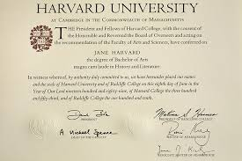
Thanks a Lot for Your Kind Participation

